Slide 1

CEREO Living Atlas
By the CEREO Living Atlas Development Team:
Yaru Gao
Jonathan Simmons
Zachary Garoutte
Sponsor: Center for Environmental Research, Education, and Outreach

Slide 2
Outline
Introduction
Project Overview & Requirements
Solution Approach
Current Status & Key Improvements
Future Work
Conclusion & Acknowledgments

Slide 3
Project Overview and Requirements
What is the CEREO Living Atlas?
The CEREO Living Atlas is a geospatial web application developed with the Center for Environmental Research, Education, and Outreach at WSU.
It supports environmental monitoring by displaying datasets like water quality, restoration work, and invasive species on an interactive map.
Its goal is to provide CEREO with an accessible, map-based platform for monitoring environmental data across the Pacific Northwest, while meeting key requirements such as highly usable user-added data, effective visualization of geospatial data, and stable performance.

Slide 4
Project Overview and Requirements (Cont.)
Existing Problems
Although the application was previously developed, it did not fully meet CEREO’s original vision. Several key limitations remained:
Limited Functionality for User-Added Data: Previous versions allowed users to upload cards and edit basic information, but lacked essential tools to interact with their own data.
Limited Geospatial Data Usability: There were minimal geospatial features, making it difficult for users to effectively visualize and monitor environmental conditions.
Technical Issues: Multiple bugs affected file attachments, password resetting, and card/pin display, along with other stability problems.
Our Development Focus
Our team enhanced the existing Atlas by improving usability, expanding geospatial data capabilities, and resolving technical issues to better support users’ needs.

Slide 5
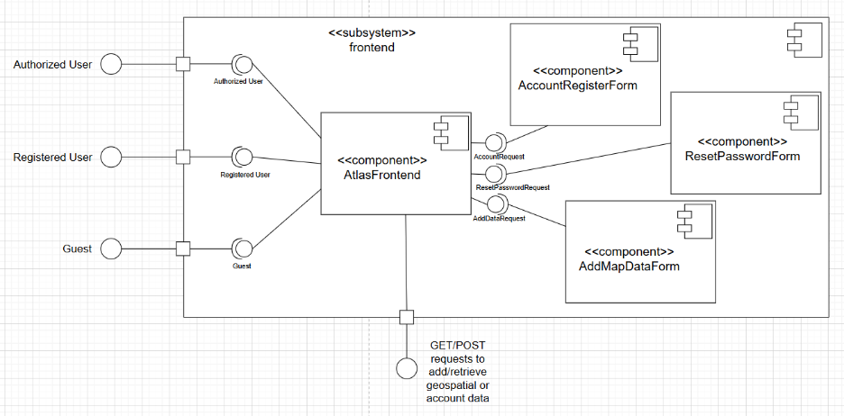
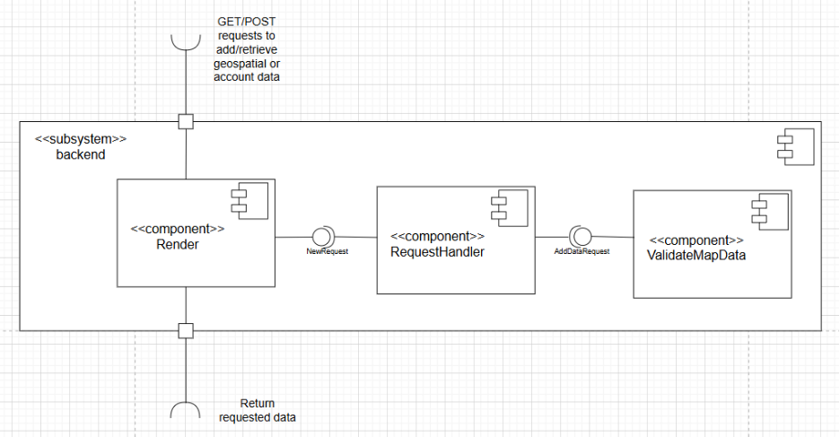
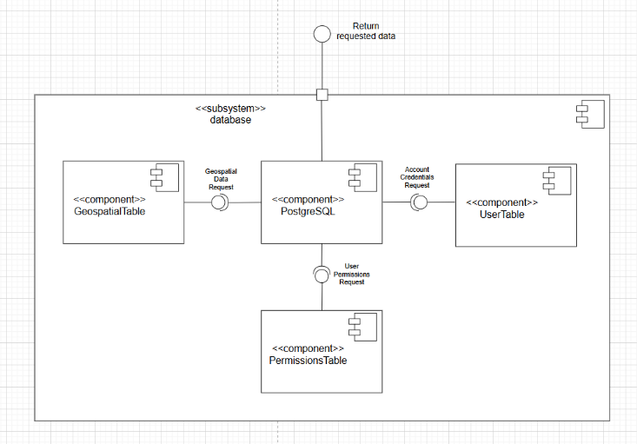
Project Solution Approach
System Architecture
The system is built as a web application composed of three main subsystems:
Frontend — React.js (Netlify)
Provides a user-friendly interface and interactive Mapbox-powered map.
Backend — FastAPI (Render)
Handles API requests, authentication, and communication between UI and database.
Database — PostgreSQL (Azure)
Stores geospatial data, user credentials, and dataset metadata.
(The images on the right show the subsystem diagrams for the frontend, backend, and database components.)
Tools & Technologies
The enhancement of the Living Atlas continues using the existing technology stack while expanding capabilities.
We focus on:
Improving usability of user-added data
Integrating external ArcGIS geospatial data from sources such as WA Department of Ecology and other agencies
Fixing existing bugs to enhance stability and performance

Slide 6
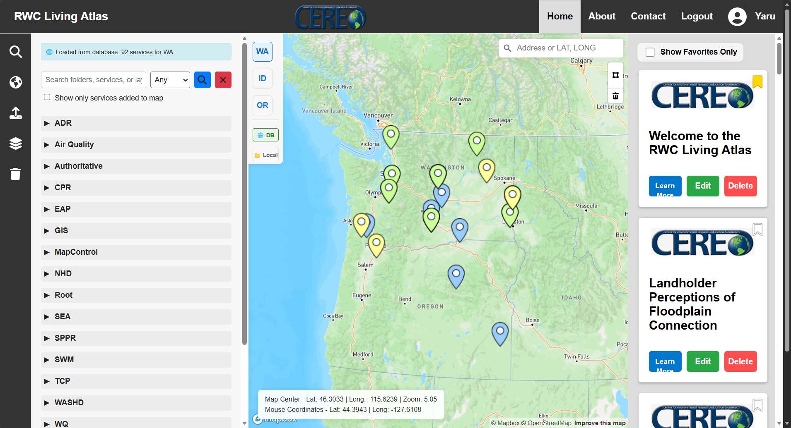
Project’s Current Status
User-Added Data Usability Enhancements
Sorting and bookmarking are supported.
File attachments can be downloaded.
Custom thumbnails can be uploaded.
A location can be selected on the map when uploading data.
Pins can be clicked to zoom in to their locations.
Geospatial Data Visualization & Management
ArcGIS MapServer layers from WA Ecology and other agencies have been integrated, enabling users to visualize environmental data on the map and manage fetched ArcGIS items, including renaming or deleting them.
Default hydrological and city boundary layers can be toggled on and off.
Bug Fixings
Most bugs from previous versions have been fixed, including data-loading failures and account-recovery issues, along with other errors.
UI Refinement
The user interface has been improved for easier navigation, reduced redundancy, and better scaling across devices.

Slide 7
Project’s Future Work
Performance: Improve loading speed when displaying ArcGIS data.
Security: Strengthen authentication, encryption, and defenses against cyberattacks, including support for multi-factor authentication (2FA/MFA) to protect user accounts.
Usability: Support additional ArcGIS data types beyond MapServer (e.g., FeatureServer) to enable more interactive and editable geospatial features.
User-Friendliness: Provide an in-app tutorial or AI assistant to help users navigate key functionalities.
Accessibility: Ensure the application complies with the university’s UPPM 10.45 and USER-01 Accessibility Policy.

Slide 8
Thank you for viewing our presentation.
We gratefully acknowledge:
• Our mentor Ananth Jillepalli for continuous guidance
• Julie Padowski and Jan Boll from CEREO for their collaboration and feedback
• Previous development teams for laying the foundation of this project

